Slide 1
Smart home automation
By: Md Kaif

Slide 2
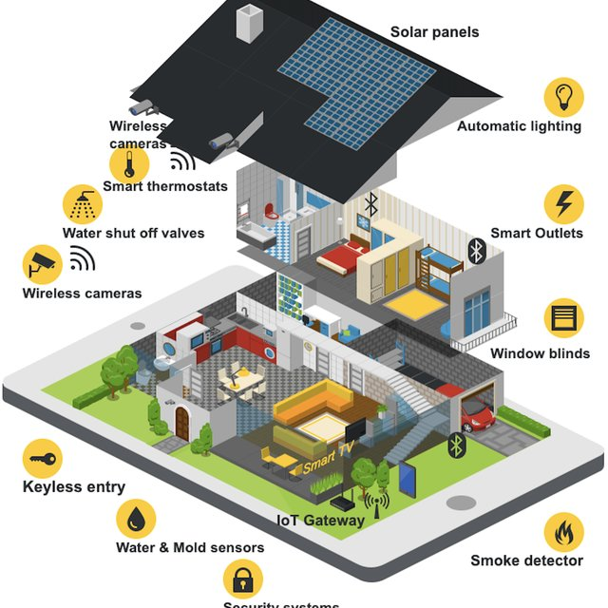
introduction
Smart home automation refers to controlling household appliances automatically using technology like sensors, microcontrollers, and the Internet of Things (IoT).

Slide 3
* Design a cost-effective home automation system. * Remotely control devices using a smartphone. * Ensure user convenience and energy savings.
objective

Slide 4
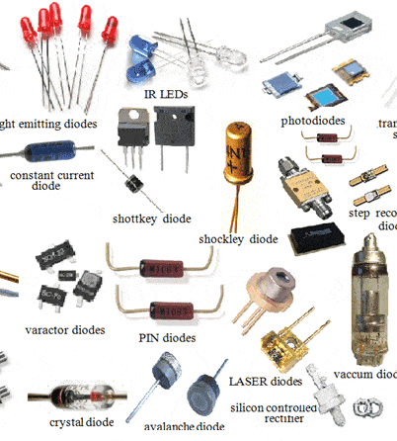
Components used:-
ARDUINO UNO R3
RELAY
SENSORS (LDR, PIR, ULTRASONIC DISTANCE SENSOR)
JUMPER WIRES
APPLIANCES(FAN, BULB, ETC.)
RESISTORS
POWER SUPPLY
SWITCH

Slide 5
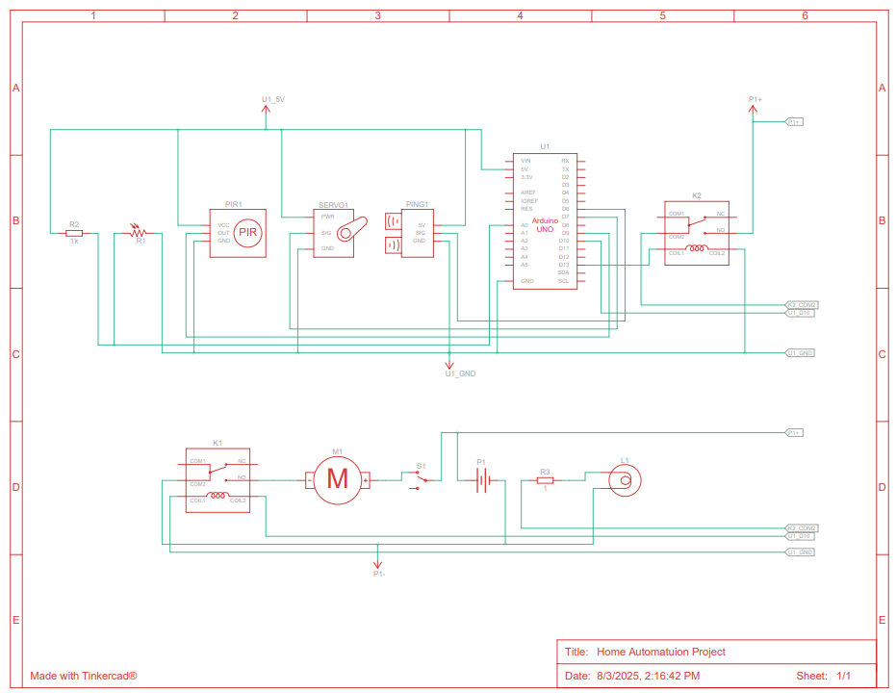
SCHEMATIC DIAGRAM

Slide 6
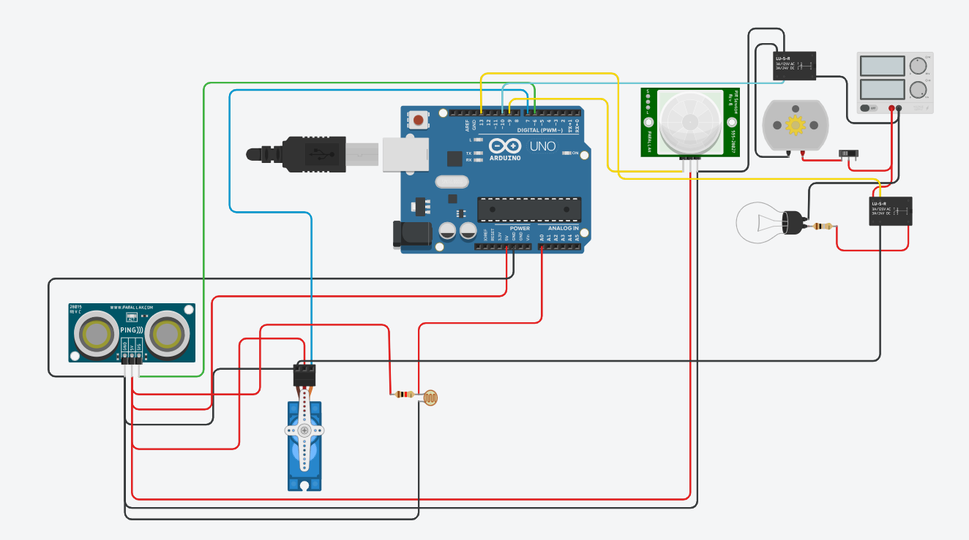
BEFORE SIMULATION

Slide 7
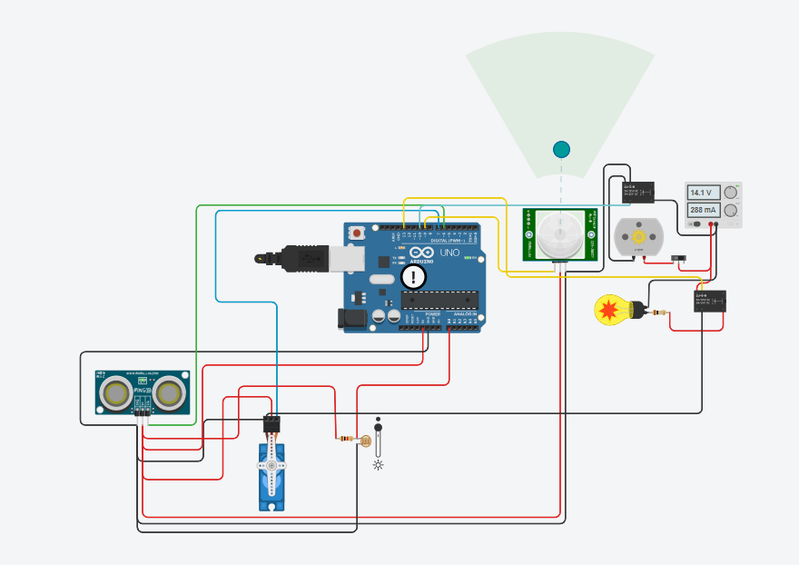
AFTER SIMULATION

Slide 8
Arduino code:-
#include <Servo.h>
int output1Value = 0;
int sen1Value = 0;
int sen2Value = 0;
int const gas_sensor = A1;
int const LDR = A0;
int limit = 400;
long readUltrasonicDistance(int triggerPin, int echoPin)
{
pinMode(triggerPin, OUTPUT); // Clear the trigger
digitalWrite(triggerPin, LOW);
delayMicroseconds(2);
// Sets the trigger pin to HIGH state for 10 microseconds
digitalWrite(triggerPin, HIGH);
delayMicroseconds(10);
digitalWrite(triggerPin, LOW);
pinMode(echoPin, INPUT);
// Reads the echo pin, and returns the sound wave travel time in microseconds
return pulseIn(echoPin, HIGH);
}
Servo servo_7;
void setup()
{
Serial.begin(9600); //initialize serial communication
pinMode(A0, INPUT); //LDR
pinMode(A1,INPUT); //gas sensor
pinMode(13, OUTPUT); //connected to relay
servo_7.attach(7, 500, 2500); //servo motor
pinMode(8,OUTPUT); //signal to piezo buzzer
pinMode(9, INPUT); //signal to PIR
pinMode(10, OUTPUT); //signal to npn as switch
pinMode(4, OUTPUT); //Red LED
pinMode(3, OUTPUT); //Green LED
}
void loop()
{
//------light intensity control------//
//--------------------------------------------------------------
int val1 = analogRead(LDR);
if (val1 > 500)
{
digitalWrite(13, HIGH);
Serial.print("Bulb ON = ");
Serial.print(val1);
}
else
{
digitalWrite(13, LOW);
Serial.print("Bulb OFF = ");
Serial.print(val1);
}
//--------------------------------------------------------------
//------ light & fan control --------//
//--------------------------------------------------------------
sen2Value = digitalRead(9);
if (sen2Value == 0)
{
digitalWrite(10, LOW); //npn as switch OFF
digitalWrite(4, HIGH); // Red LED ON,indicating no motion
digitalWrite(3, LOW); //Green LED OFF, since no Motion detected
Serial.print(" || NO Motion Detected " );
}
if (sen2Value == 1)
{
digitalWrite(10, HIGH);//npn as switch ON
delay(3000);

Slide 9
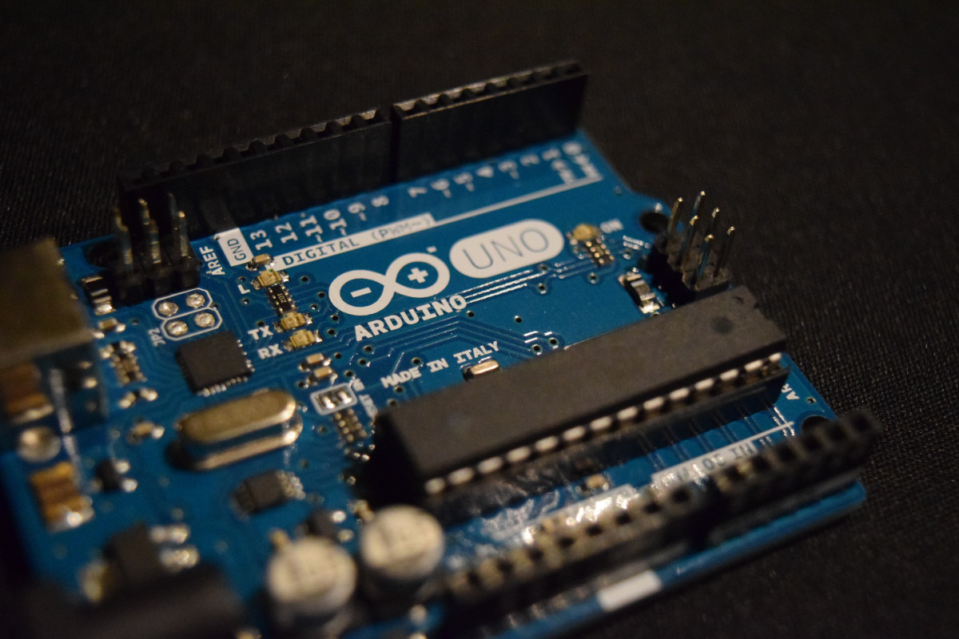
Arduino code:-
digitalWrite(4, LOW); // RED LED OFF
digitalWrite(3, HIGH);//GREEN LED ON , indicating motion detected
Serial.print(" || Motion Detected! " );
}
delay(300);
//--------------------------------------------------------------
//------- servo motor ---------//
//-------------------------------------------------------------
sen1Value = 0.01723 * readUltrasonicDistance(6, 6);
if (sen1Value < 100)
{
servo_7.write(90);
Serial.print(" || Door Open! ; Distance = ");
Serial.print(sen1Value);
Serial.print("\n");
}
else
{
servo_7.write(0);
Serial.print(" || Door Closed! ; Distance = ");
Serial.print(sen1Value);
Serial.print("\n");
}
delay(10); // Delay a little bit to improve simulation performance
}

Slide 10
WORKING PRINCIPLE
Sensors sends the data to the Arduino uno.
Based on the sensors data Arduino sends signal to the relay module using the code provided by the user.
Relay works as a switch between the appliances and output of Arduino.
For the HIGH signal relay turns ON the appliance and for the LOW signal relay turns OFF the appliance

Slide 11
features and applications
Remote Control
Automation & Scheduling
Energy Efficiency
Security & Surveillance
Realtime Alerts
Integration
Customization
Data Analytics
Access Control
Health Monitoring
Smart Energy Management
Smart Security
Lightning Control
Voice Assistance
Appliance Automation
Entertainment

Slide 12
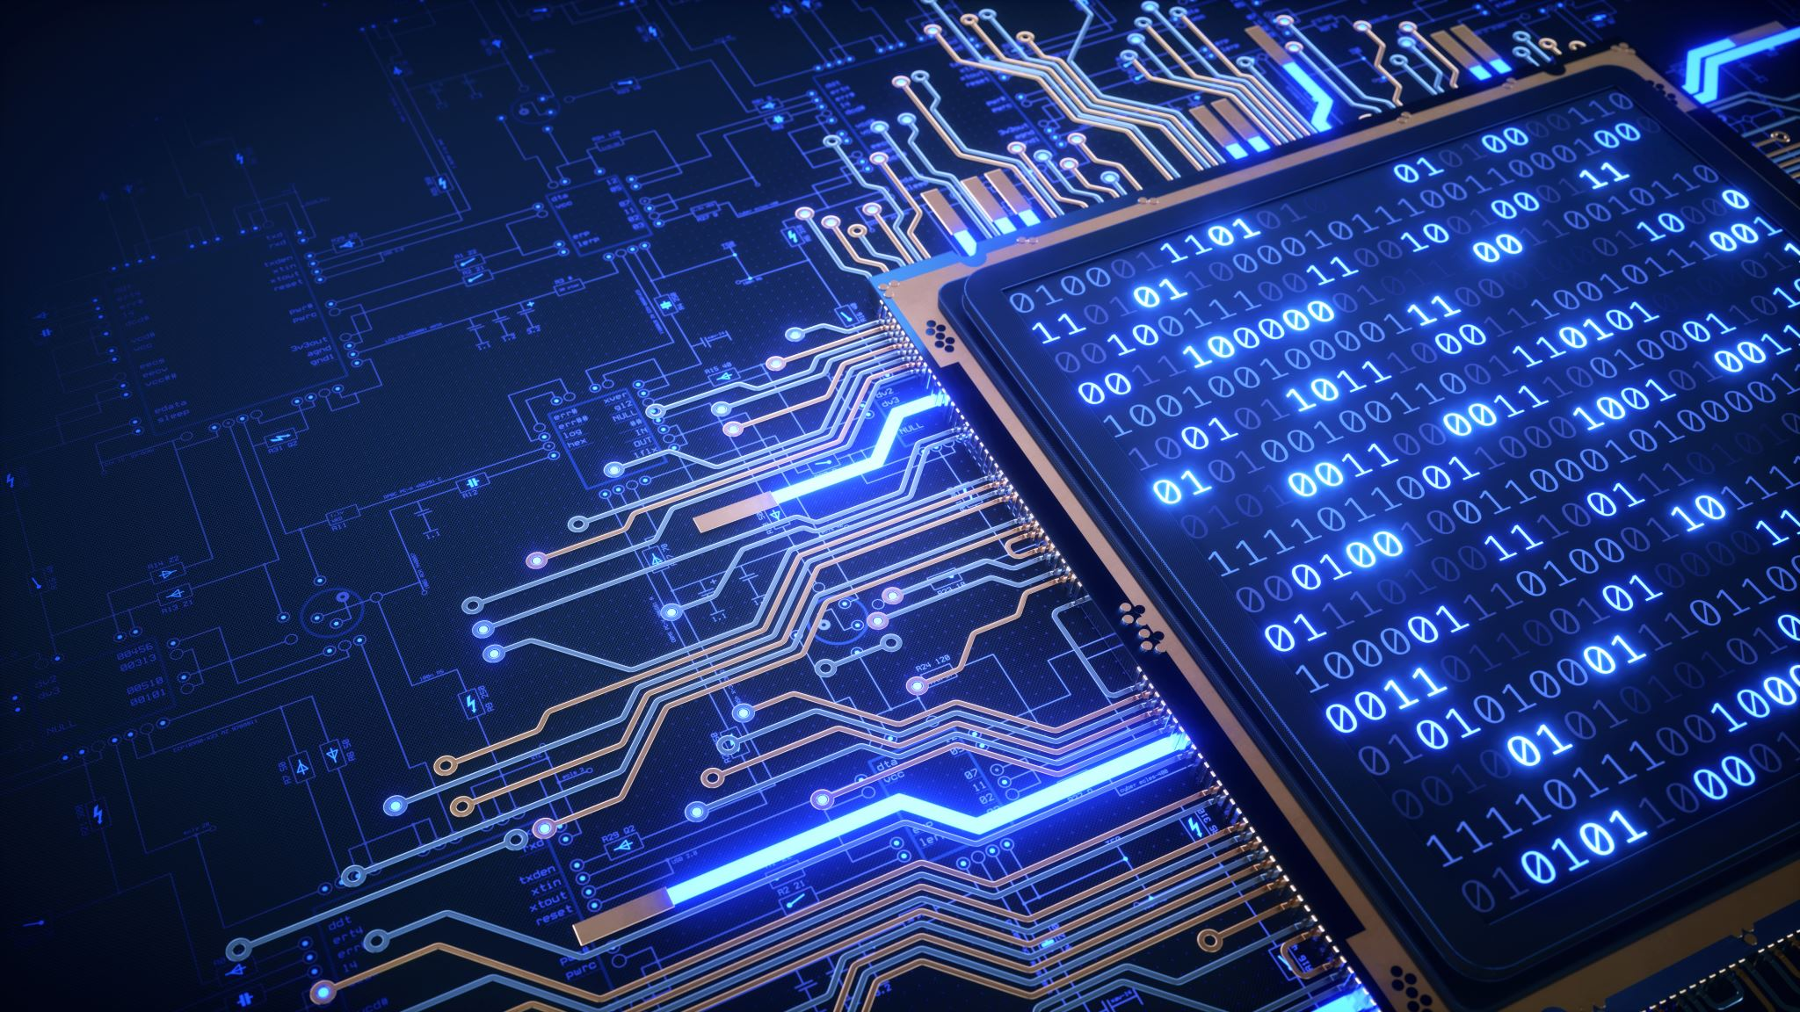
conclusion
SMART HOME AUTOMATION SIMPLIFIES LIFE.
DEMONSTRATE REAL-WORLD USE OF IOT & EMBEDDED SYSTEMS.
HAS POTENTIAL TO SCALE INTO COMMERCIAL SOLUTIONS.
IT IS REMOTELY ACCESSIBLE AND ESSENTIAL FOR A SMARTER FUTURE.

Slide 13



THANK YOU
Md Kaif
iamkaifpathaan
p0409athan@gmail.com
iamkaifbaloch (Github link in bio)
In

